Slide 1
Why C++ for Large Scale Systems?
Ankur Satle
EXFO.com
ankursatle@gmail.com

Slide 2

A question raised in the CppIndia User Group
What is it about C++ that makes it possible
to write large-scale system?

Slide 3
What is a Large-Scale System?
Is-A system
Has-A scale!
class System
{
Scale scale;
};

Slide 4
What is a Large-Scale System?
Is-A system
Has-A scale!
class System
{
Scale scale = Scale::Large;
};

Slide 5
Large-Scale Systems
They are everywhere!
Banking, Trading, Finance
Datacentres
Telecom
Government organisations
Scientific research
Reservation systems for Railways, Airlines, etc

Slide 6

Up for the challenge!

Slide 7
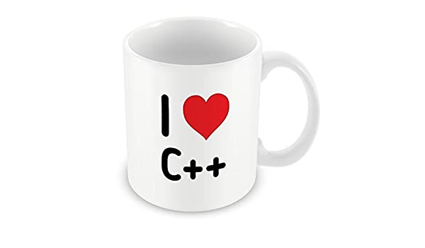
Well, because…

Slide 8
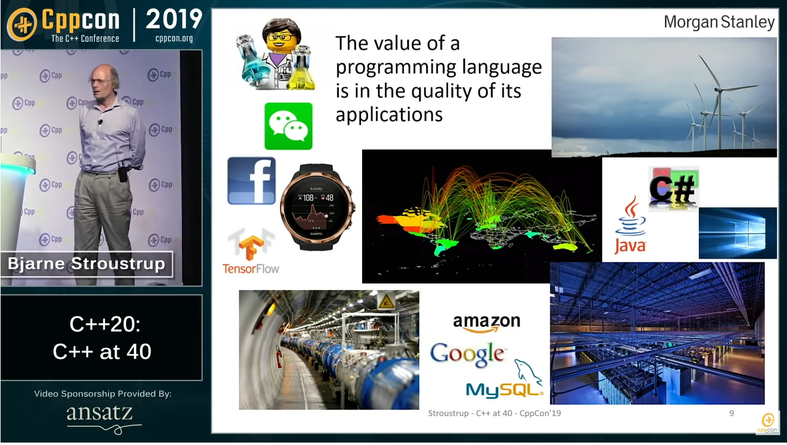
Why C++ - It’s proven

Slide 9
C++ for Expressivity & Static type system
Equal support for built-in & user-defined types
Work in the problem domain
Overloading, meta programming
Multiple paradigms supported
OO, Functional, Generic
Data-oriented
Declarative
Notes:
Declarative

Slide 10
C++ – Strong types
Have strong types, automatic conversions
Complex types treated just like fundamental ones
Value types: variant, optional, tuple
chrono, units, conversions
seconds expires = msg.expiry();
timer.start(expires);
//seconds to milliseconds – No problem!

Slide 11
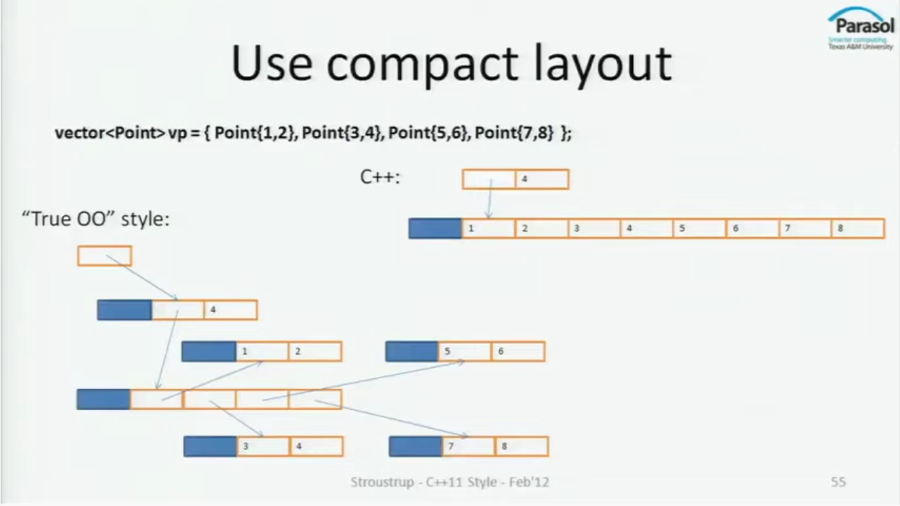
C++ - Compact memory layout
Compact data-types
Objects in contiguous memory
Maximise cache locality
Objects placed on the stack
No contention for the global heap

Slide 12
C++ – Automatic resource management
Automatic resource management
unique_ptr, shared_ptr to manage resources
Memory, File handles, Network connections, Threads
No deférence of resource release
Static scope
Deterministic lifetimes
Scope-bound
}
= default
Value Semantics
Rule of Zero

Slide 13

C++ - Exploit Hardware Facilities
Platform specific instruction set
Heterogeneous computing
NUMA, CUDA

Slide 14

C++ - Concurrency and Parallelism Support
Concurrency & parallelism
Threads, thread-pools, mutex, conditional variables.
Go async – futures & continuations
Coroutines
SIMD
Direct port to hardware
Use all you can!

Slide 15
C++ - Zero Overhead
Optimisations allow for better performance
Higher-level constructs != runtime cost

Slide 16

C++ - Stable & Portable
Stable API & ABI
Backward compatible
Write once, compile & deploy on any platform
Standard

Slide 17
C++ - Maintainability
And, just be responsible:
auto modern_cpp = cpp_superset
| filter(modern);

Slide 18
So, short answer long…
Just use

Slide 19
BONUS SLIDE!

Slide 20

Tony Van Eerd asks…
How many times should one attend cppcon to do a talk?
1

Slide 21
Thank you!
Ankur Satle
Email: ankursatle@gmail.com
Github: @sankurm
Join us at: CppIndia.co.in

